Slide 1
Merge Conflicts

Slide 2
Merge conflicts sometimes inevitably arise. There is a lot of dogma about how they should never happen, and if they do, you are doing something wrong. I would say that does not reflect the reality of collaborative projects. In principle, they are very simple to understand.
Effort should be made to avoid them if possible, but work through it if that’s what is required.
Remote Repository
A
B
C
Alice and Bob have both edited File C. There are several options (probably option one or two are best):
Bob can push, and Alice can fetch, then manually review the conflict, and decide whose file to keep, then merge, handle the merge conflict how she planned, and then consult Bob about adopting his binned changes to her version of File C (or vice versa)
Bob can push, and Alice can revert or reset her unpushed commit(s) if the effort required to resolve the conflict is less than redoing the feature, or if both of you have accidentally overlapped and completed similar work (or vice versa)
Bob can push, Alice can rebase her commit and handle the merge conflicts from behind (or vice versa)
If Bob pushed, any push from Alice will be rejected, because it will make her behind, though Alice can force push (the nuclear option, a last resort) which will overwrite whatever commits Bob has made that conflict her changes (disabled on a lot of repositories for non-admins)
NB. If the merge conflict is overwhelming or taking up more time than you expected (many files), you can abort it and come back to it another time or get backup.
Alice’s Local Repository
Bob’s Local Repository
A
A
B
B
C
C

Slide 3
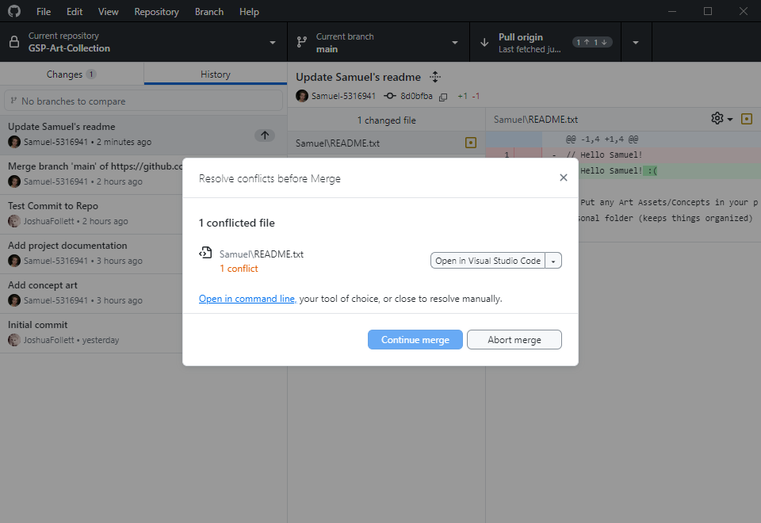
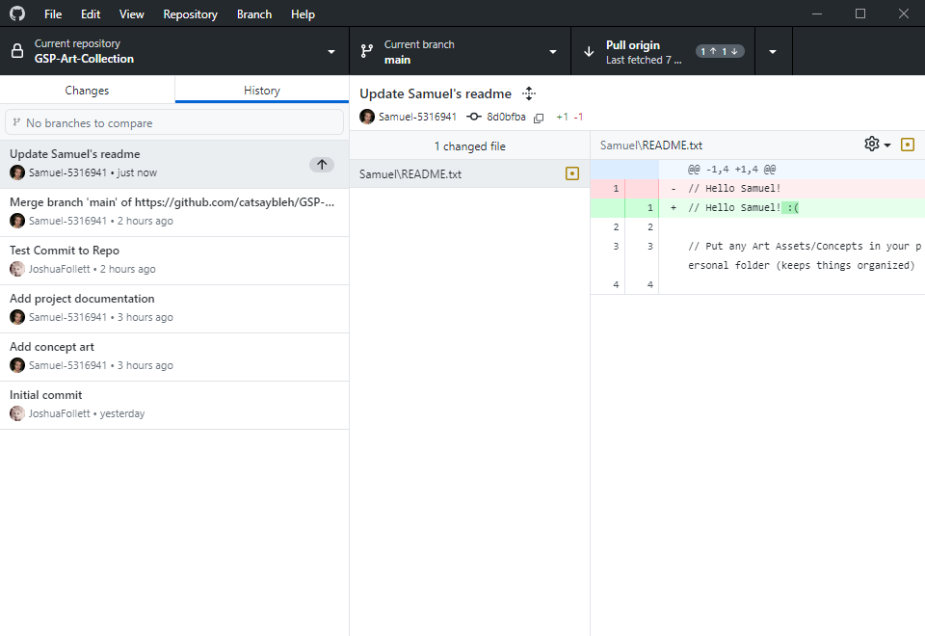
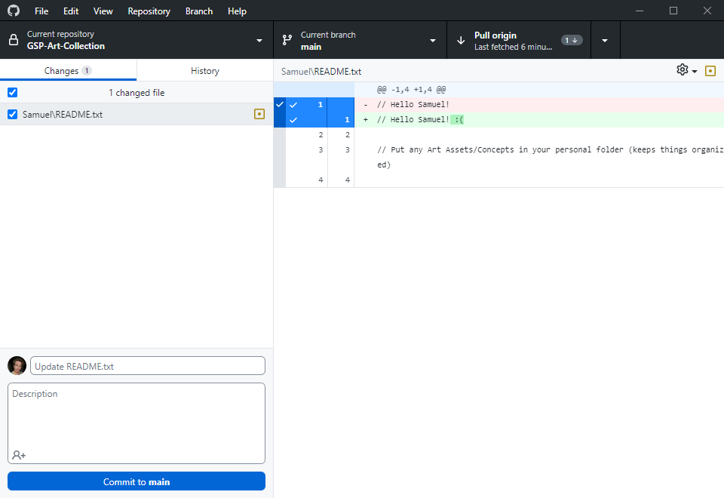
MERGE CONFLICTS
You can see I have edited a text file.
Now I will commit this change.
Now I have fetched before pushing. You can see I have one commit to push (my text file) and I am also one commit behind (Josh has made a commit). We need to pull the changes Josh made into my commit and create a merge commit before I can push.
We have run into a merge conflict. In my commit, there are files which were also edited in Josh’s commit.
If the merge conflict is too complex, you can abort it and call for backup.
Only when you have resolved all conflicts will it be possible to continue merge.
With text files, Git will manage a lot of the merge scenarios intelligently.
However, with art assets, this is reduced to a simple choice. Unity assets normally are incompatible for an intelligent or graceful merge. You will need to choose one or the other and we will treat this text file the same way.

Slide 4
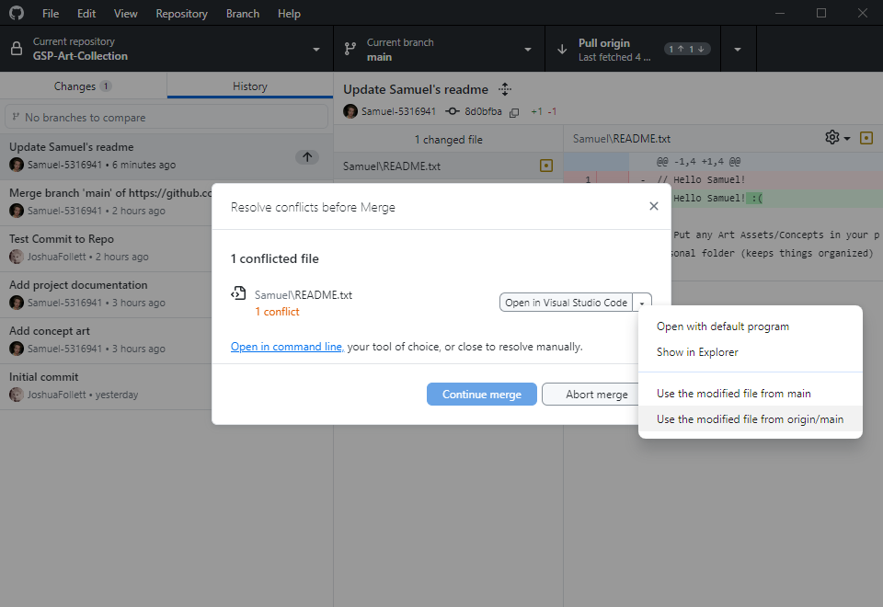
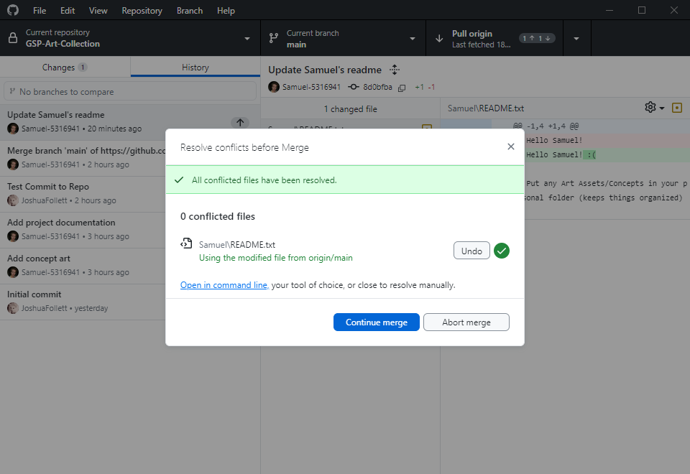
MERGE CONFLICTS (cont)
If you expand the dropdown, you can see two options:
Use modified file from main
Use modified file from origin/main
Here, main refers to the name of the branch you are on. Yours may not be called main (this is normally a protected branch).
The main consideration here is that the file from origin is the one you’ve pulled in, and the other is the file you edited that’s conflicting. You can choose one or the other. I will choose the one from origin to overwrite by file.
If I am so inclined, I might copy out my file to another directory to preserve it for now, before I choose Josh’s file, and add the changes back in later. This is completely acceptable, although Git methodology says that you should stash your changes and merge over them. You can also abort and try a rebase. I won’t cover those options but I mention them in the case you want to learn more elsewhere.

Slide 5
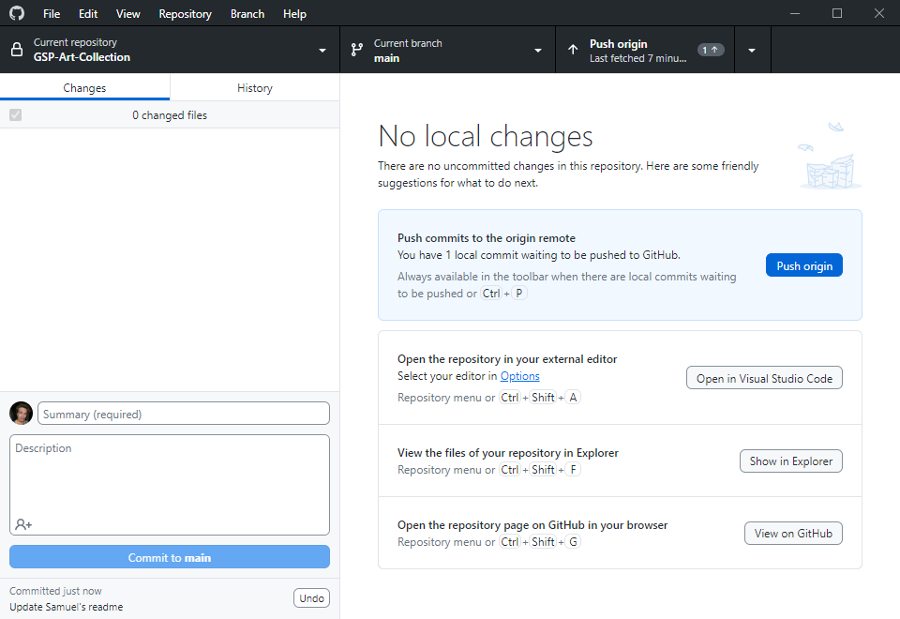
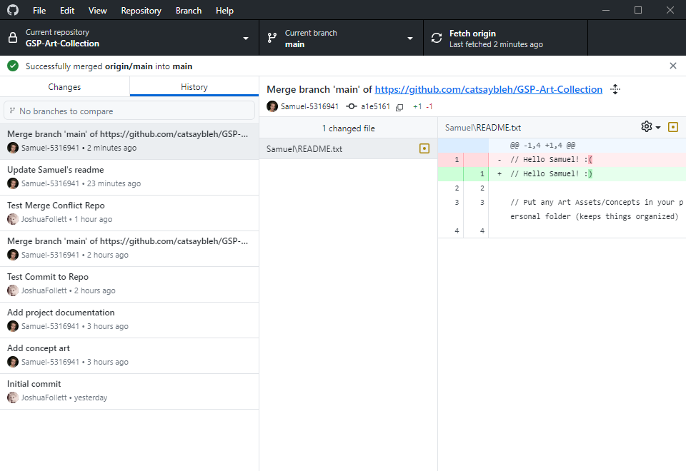
MERGE CONFLICTS (cont)
Now, you can see in the history that a merge commit has been created. The merge was successful but this still only locally available. I need to push my merge commit to fully resolve the conflict.
I must fetch again, and if there are no commits to pull, I will push my changes.
If you make a mistake, you can undo the latest unpushed commit right underneath the commit button. There are two types of “undo”: revert and reset. Git often will intelligently choose for you, but if it asks you for help deciding:
Revert is preservative: it changes the commit you made (and directory) to match the specified previous commit.
Reset is destructive in that it erases the commit, and depending on the type of reset, it can revert your files too.
If you made a mistake and want to undo the commit and the revert files, reset hard.
If you committed the wrong files but want to keep the edits you made, reset soft. This will undo the commit but leave the files alone and automatically stage them.
You should only try to undo pushed commits if you know the implications.

